Slide 1
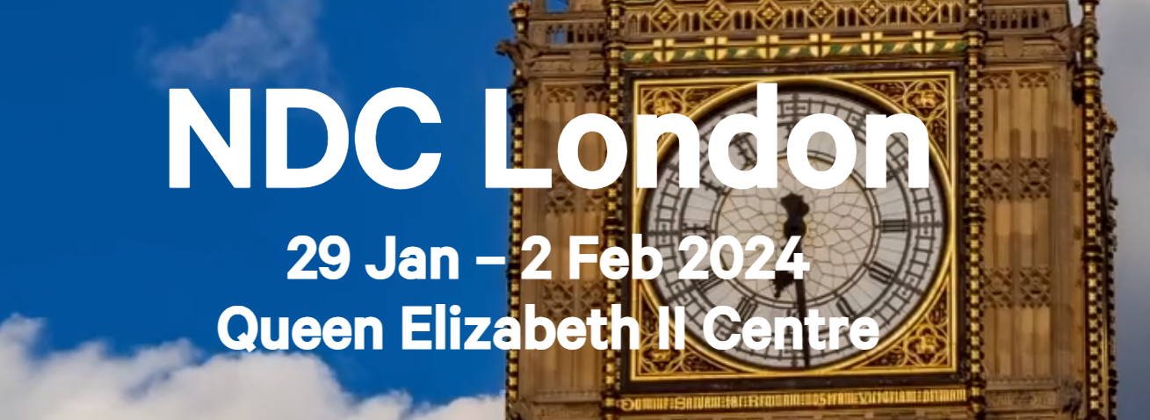

Eric Williams
Recap of the 2024 NDC London Conference
ewilliams@cenero.com

Slide 2
2 Day Workshop
Overview
The conference spanned a total of 5 Days covering all things computer science related with a strong emphasis on dotnet development and dotnet technologies.
I attended an optional 2-day workshop focused on Domain Driven Design, Event Sourcing, and CQRS (well sort of).
Vendors
3 Days Lectures
Several vendor booths showcasing technologies
- Raven DB
- Couche Base
Attended roughly 24 hours worth of 1 hour lecterns on a variety of topics, links in presentation.

Slide 3
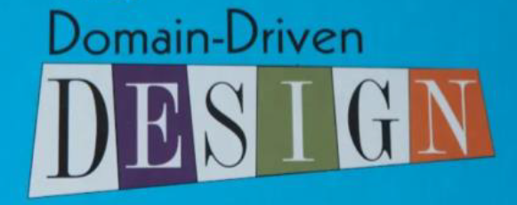
Workshop
Event Sourcing
Using commands and events to model data in a system
CQRS
Command and Query Response Separation. A design pattern that requires a separate write model from a read model. Allows read and write optimizations.
Domain Driven Design
Model a software application around domain specific terminology

Slide 4
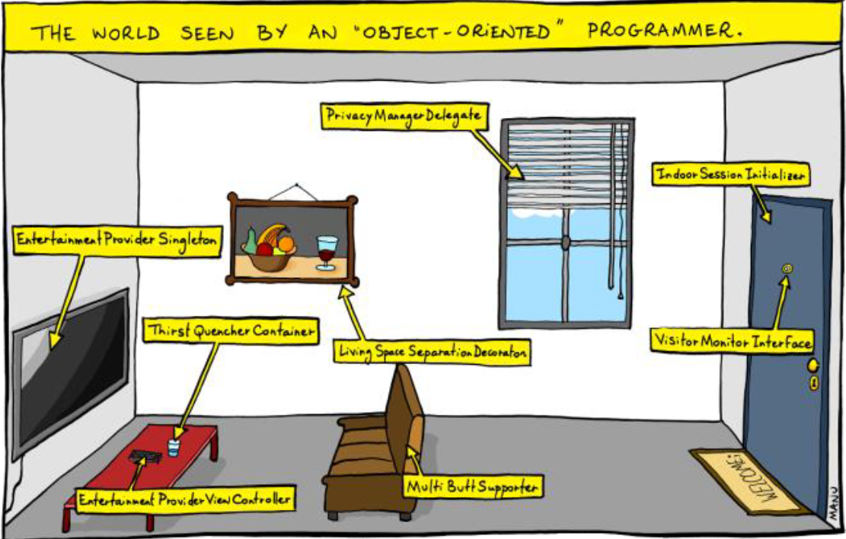
Domain Driver Design
To remove interpretations, we must share a common language.
A ubiquitous language is
A vocabulary shared by everyone involved in a project.

Slide 5
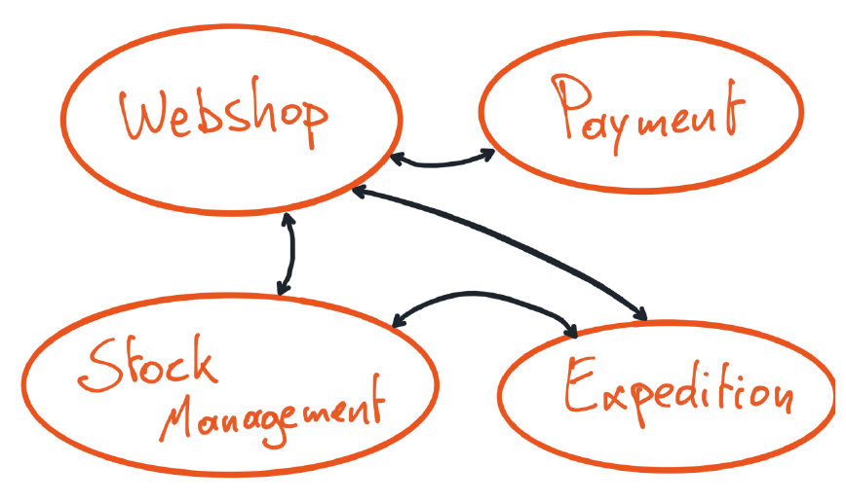
Bounded Context
Ensuring related code stays within its boundaries

Slide 6
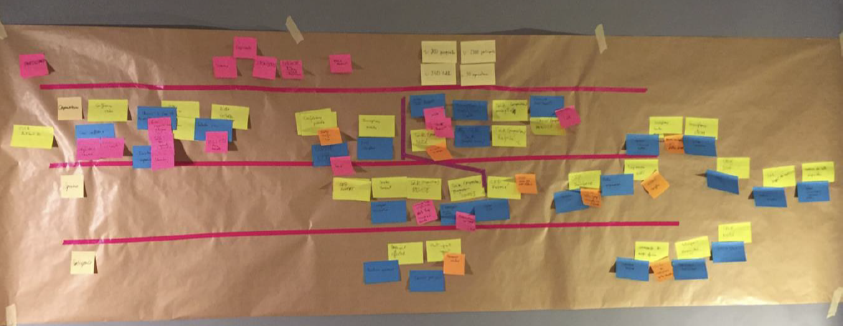
Event Storming
A human processor to determine boundaries, language, and vocabulary used within an application.
Commands
Events
Value Objects
Aggregates
Policies

Slide 7
Event Storming Practicum
Lets model our problem domain, “because every domain is in fact a problem” – EW circa 2024
We test your system every night
We dispatch field service engineers
We monitor your devices!
We want reports
We have a dashboard
We maintain your systems integrity.

Slide 8
Event Sourcing
Don’t store state! Store events, project state as needed
Device went Online
IP Changed to 192.168.5.5
Energy consution increased to 30%
Energy consution decreased to 10%
Write Model
Our write model stores the events, things that has happened, things that can never change.
We can project the current state as
{
online: true,
ip: 192.168.5.5,
energy: 10%
}
Read Model
Our read model can now project the state as needed at any point in time.

Slide 9
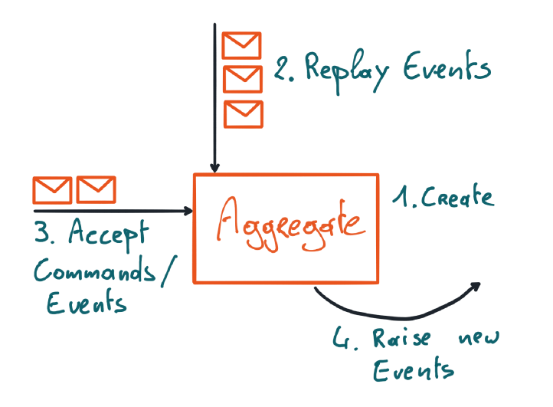
Aggregate Lifecycle
So the cycle begins, a new aggregate has been created.
Created
Our new aggregate is created
Replayed
Events are iterated until all events have been replayed.
New Commands are Accepted
Our aggregate can now accept new commands.
Raise Events
Raise new events based on state and command.

Slide 10
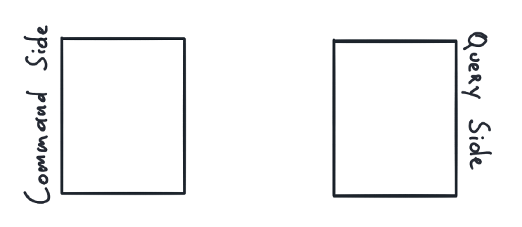
CQRS
Segregates commands and query responsibility. One has NO idea the other even exists.

Slide 11
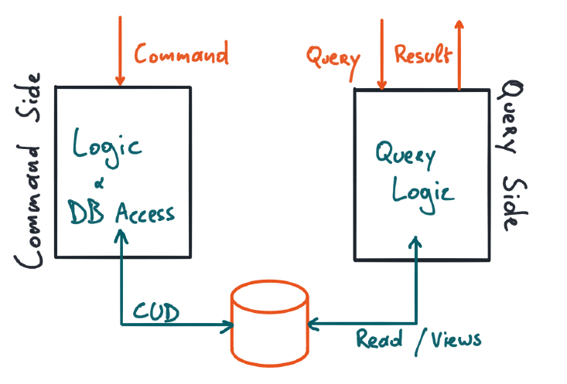
CQRS
Segregates commands and query responsibility. One has NO idea the other even exists.

Slide 12
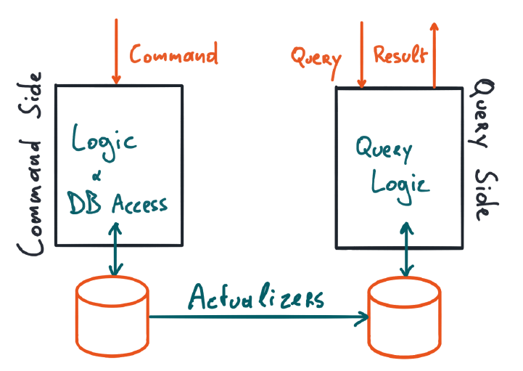
CQRS
Segregates commands and query responsibility. One has NO idea the other even exists.

Slide 13
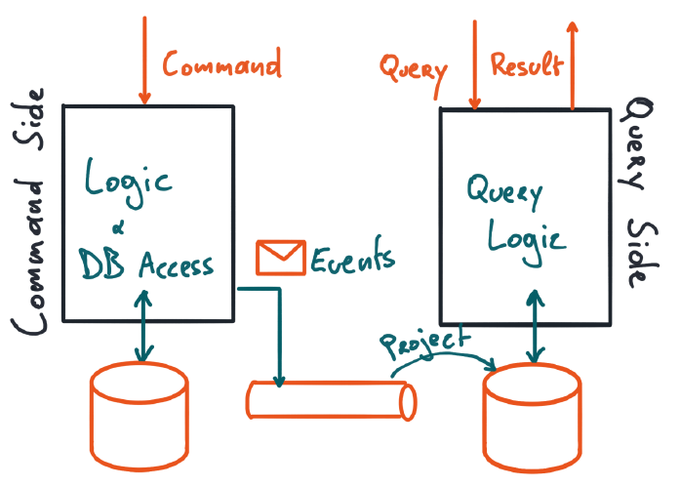
CQRS
Segregates commands and query responsibility. One has NO idea the other even exists.

Slide 14
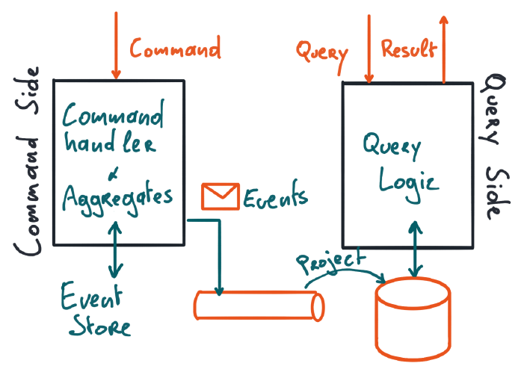
CQRS
Segregates commands and query responsibility. One has NO idea the other even exists.

Slide 15
Resources
WHAT NOT TO DO: Top 5 techniques for building the worst microservice system ever - William Brander - NDC Porto 2023 – YouTube
C# 12: https://www.youtube.com/watch?v=zpYC7MYaJJs&si=gpDihovYmc58ySFg
KEY NOTE: Mirror, mirror on the wall... Am I a critical thinker after all? - Laila Bougria - NDC Porto 2023 – YouTube
ASYNC AWAIT: Correcting Common Async/Await Mistakes in .NET 8 - Brandon Minnick - NDC Porto 2023 – YouTube
OPEN TELEMETRY: Practical OpenTelemetry for .NET - Martin Thwaites - Copenhagen DevFest 2023 – YouTube
Eric Williams
ewilliams@cenero.com

